Slide 1
A Look At CIS Security Benchmarks (2)
Mobile devices, network devices, desktop software, multifunction print devices

Slide 2
A Look At CIS Security Benchmarks (2)
# | MOBILE DEVICES | TOTAL
1 | APPLE IOS | 5
2 | GOOGLE ANDROID | 3
 | TOTAL BENCH MARKS MOBILE DEVICES | 8

Slide 3
A Look At CIS Security Benchmarks (2)
# | NETWORK DEVICES | TOTAL
1 | CISCO | 4
2 | PALO ALTO NETWORKS | 2
 | TOTAL BENCH MARKS NETWORK DEVICES | 6

Slide 4
A Look At CIS Security Benchmarks (2)
# | DESKTOP SOFTWARE | TOTAL
1 | MICROSOFT OFFICE | 13
2 | GOOGLE CHROME (WEB BROWSER) | 1
3 | MS EXCHANGE SERVER | 3
4 | MS INTERNET EXPLORER | 2
5 | MOZILLA FIREFOX | 2
 | TOTAL BENCH MARKS DESKTOP SOFTWARE | 21

Slide 5
A Look At CIS Security Benchmarks (2)
# | MULTIFUNCTION PRINT DEVICES | TOTAL
1 | MULTIFUNCTION DEVICE | 1
 | TOTAL BENCH MARKS MULTIFUNCTION PRINT DEVICES | 1

Slide 6
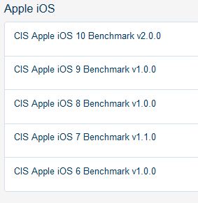
A Look At CIS Security Benchmarks (2)

Slide 7
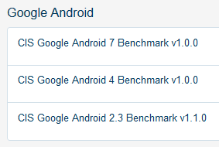
A Look At CIS Security Benchmarks (2)

Slide 8
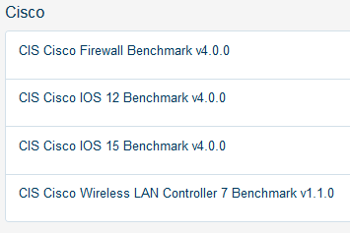
A Look At CIS Security Benchmarks (2)

Slide 9
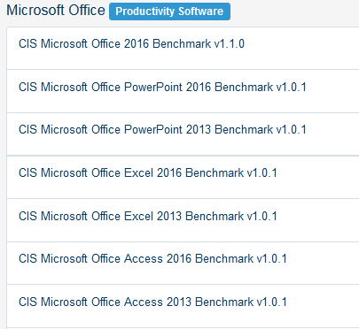
A Look At CIS Security Benchmarks (2)

Slide 10
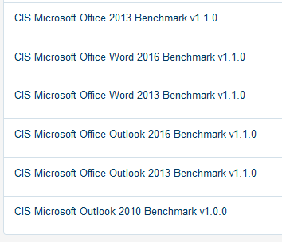
A Look At CIS Security Benchmarks (2)

Slide 11
A Look At CIS Security Benchmarks (1)
Next module…further details
END

